Slide 1
Georgia’s Initial Work with Surrogates for County NR Emission Allocations
Gil Grodzinsky,
Georgia EPD - Air Protection Branch
2016 Nonroad Collaborative Work Group
July 26, 2018

Slide 2
KEY FIRST SOURCES FOR APPROACH
      “Geographic Allocation of Nonroad Engine Population Data to the State and County Level”, published in 2005 https://nepis.epa.gov/Exe/ZyNET.exe/P1004LDX.txt?ZyActionD=ZyDocument&Client=EPA&Index=2000%20Thru%202005&Docs=&Query=%28Lawn%20Garden%29%20OR%20FNAME%3D%22P1004LDX.txt%22%20AND%20FNAME%3D%22P1004LDX.txt%22&Time=&EndTime=&SearchMethod=1&TocRestrict=n&Toc=&TocEntry=&QField=&QFieldYear=&QFieldMonth=&QFieldDay=&UseQField=&IntQFieldOp=0&ExtQFieldOp=0&XmlQuery=&File=D%3A%5CZYFILES%5CINDEX%20DATA%5C00THRU05%5CTXT%5C00000021%5CP1004LDX.txt&User=ANONYMOUS&Password=anonymous&SortMethod=h%7C-&MaximumDocuments=1&FuzzyDegree=0&ImageQuality=r75g8/r75g8/x150y150g16/i425&Display=hpfr&DefSeekPage=x&SearchBack=ZyActionL&Back=ZyActionS&BackDesc=Results%20page&MaximumPages=1&ZyEntry=14&slide
      MOVES default database (listing methodology and listing by county): nrsurrogate, nrequipmenttype, nrgrowthpattern tables (access by browser/workbench)
      Allocation files included in MOVES installation: …MOVES2014a\NONROAD\NR08a\DATA\ALLOCATE
      Sources provided to this group
2

Slide 3
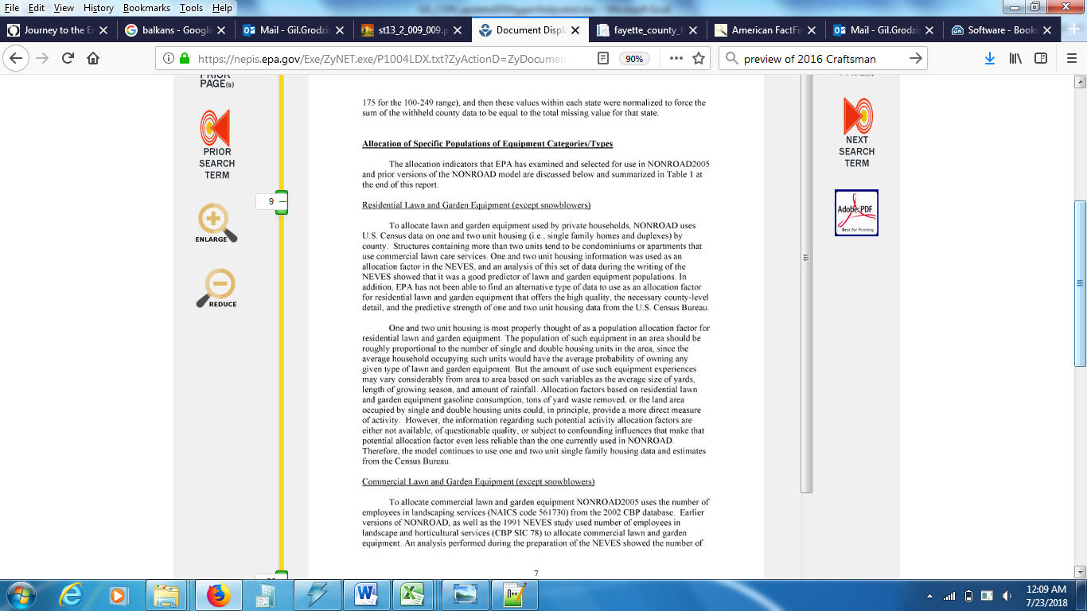
“Geographic Allocation of Nonroad Engine Population Data to the State and County Level”, published in 2005
3

Slide 4
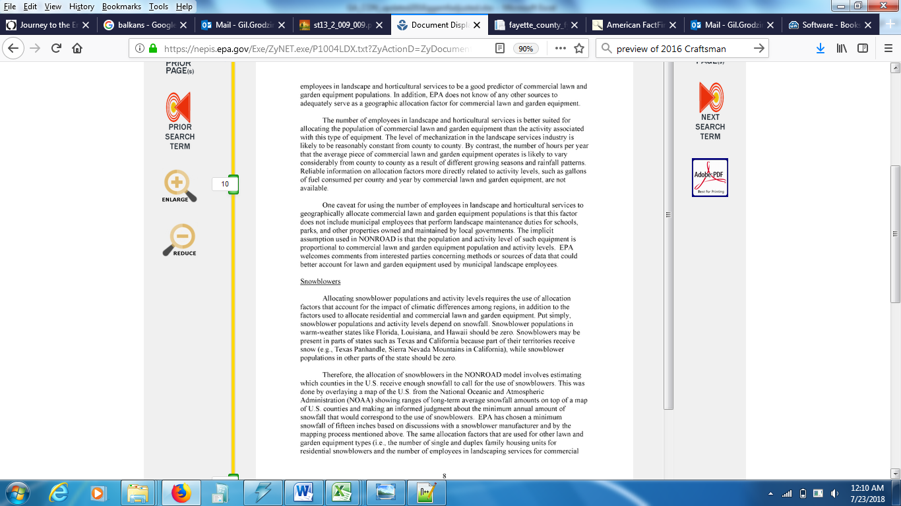
“Geographic Allocation of Nonroad Engine Population Data to the State and County Level”, published in 2005
4

Slide 5
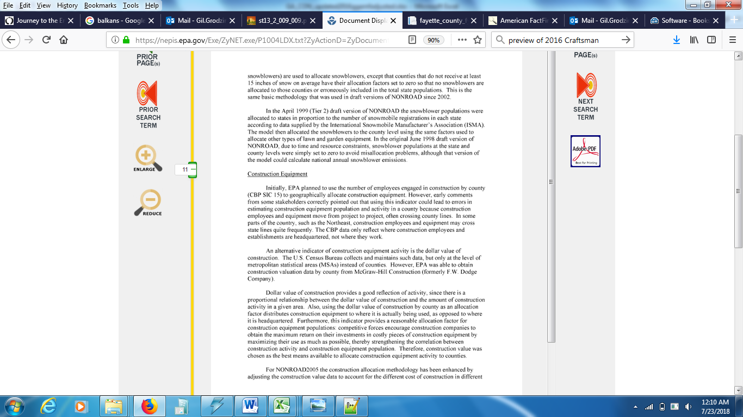
“Geographic Allocation of Nonroad Engine Population Data to the State and County Level”, published in 2005
5

Slide 6
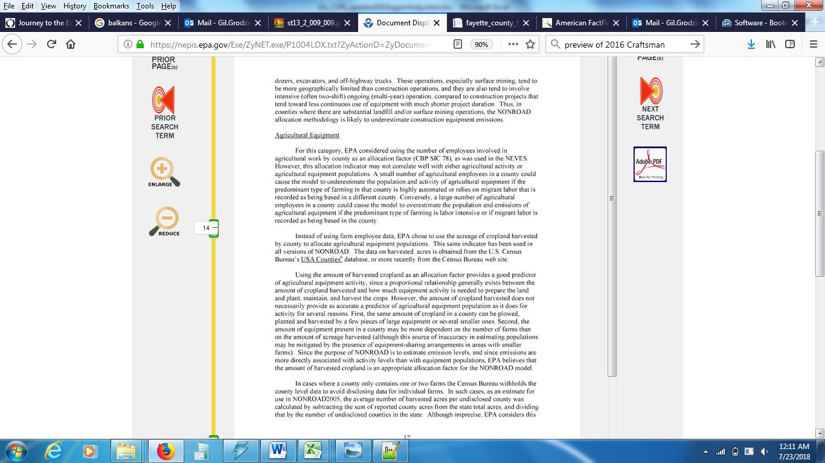
“Geographic Allocation of Nonroad Engine Population Data to the State and County Level”, published in 2005
6

Slide 7
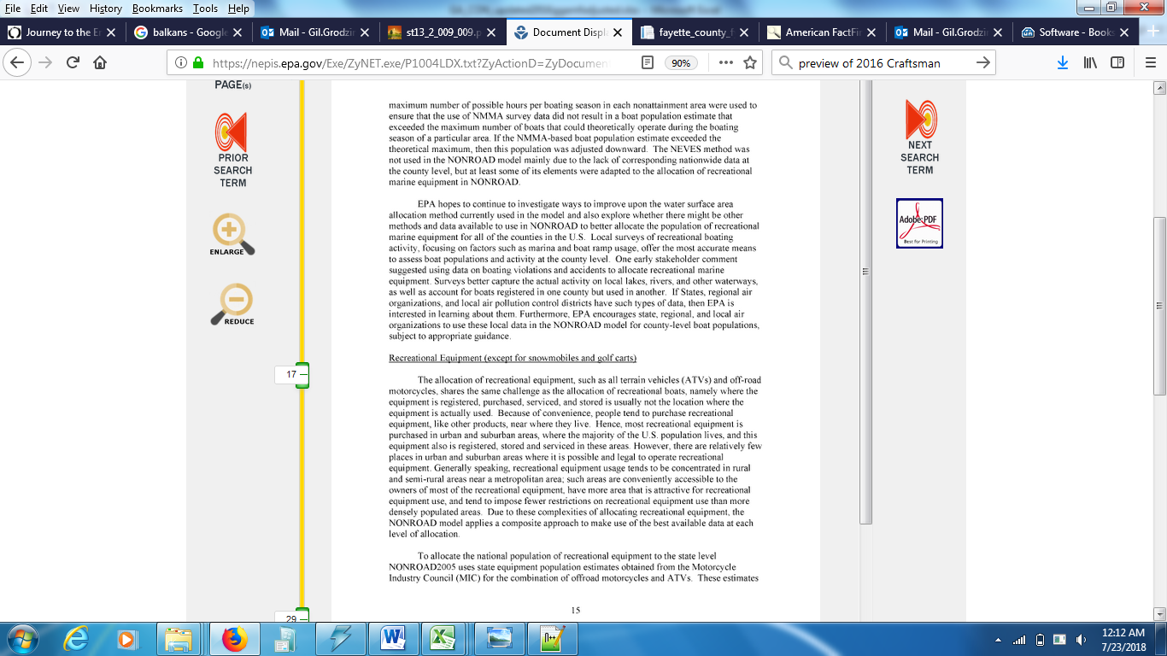
“Geographic Allocation of Nonroad Engine Population Data to the State and County Level”, published in 2005
7

Slide 8
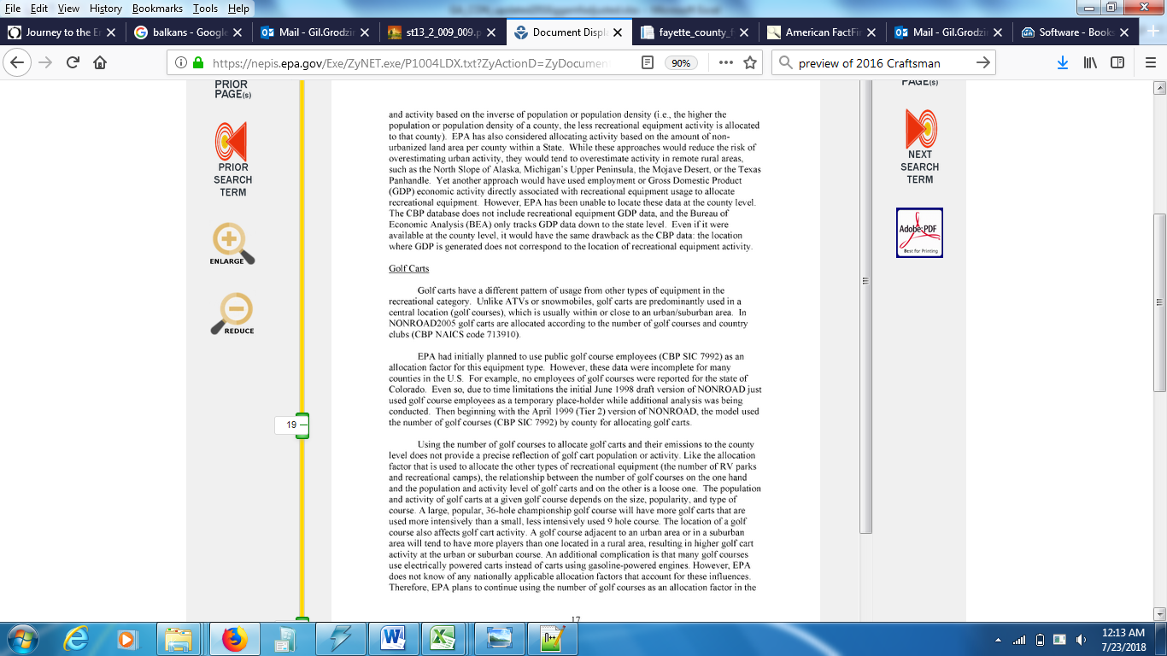
“Geographic Allocation of Nonroad Engine Population Data to the State and County Level”, published in 2005
8

Slide 9
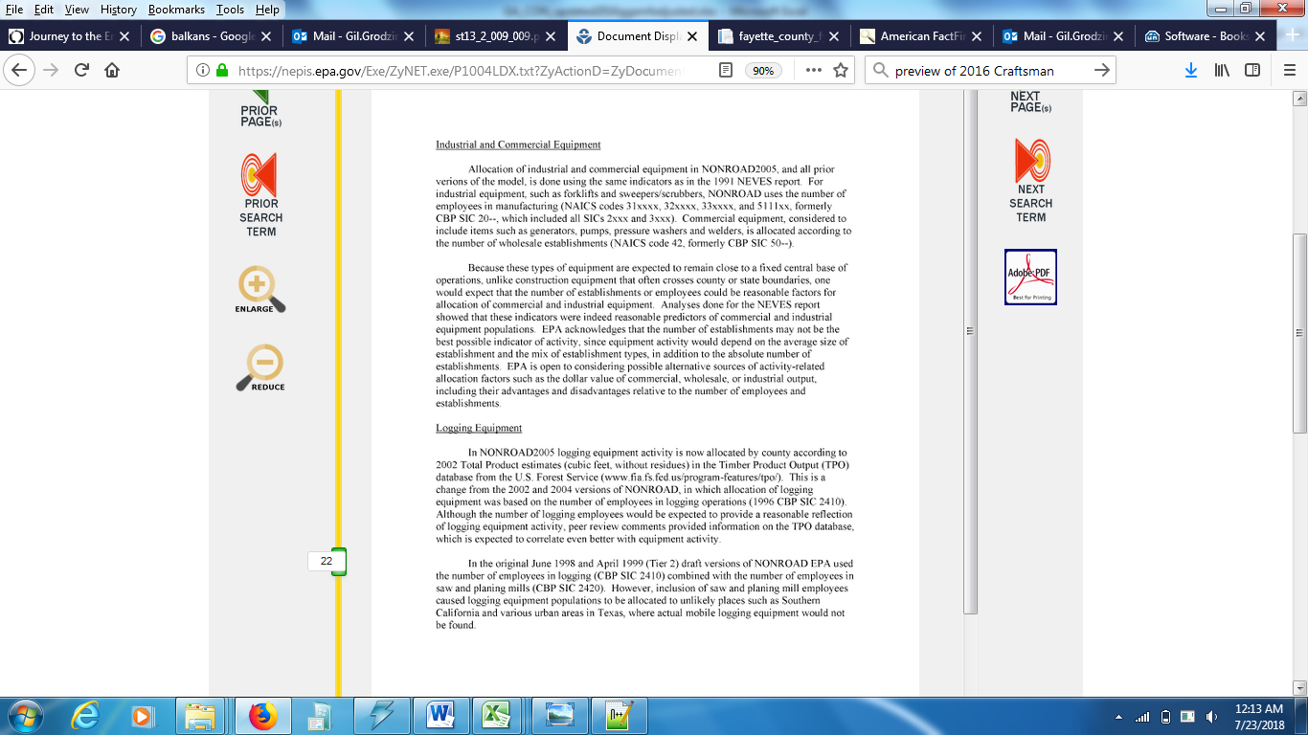
“Geographic Allocation of Nonroad Engine Population Data to the State and County Level”, published in 2005
9

Slide 10
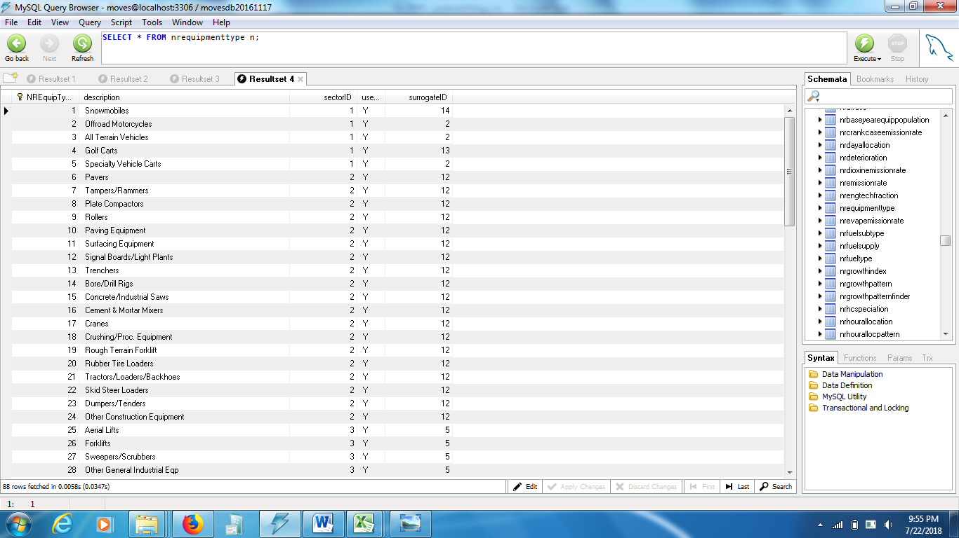
MOVES default database-nrequipmenttype
10

Slide 11
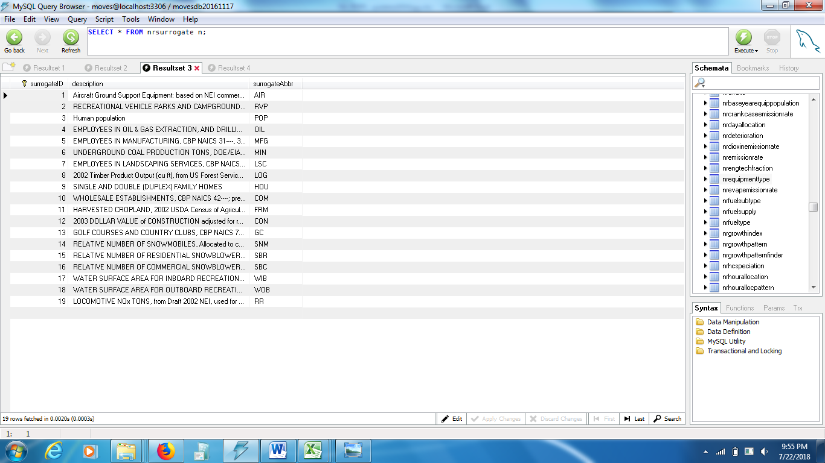
MOVES default database-nrsurrogate
11

Slide 12
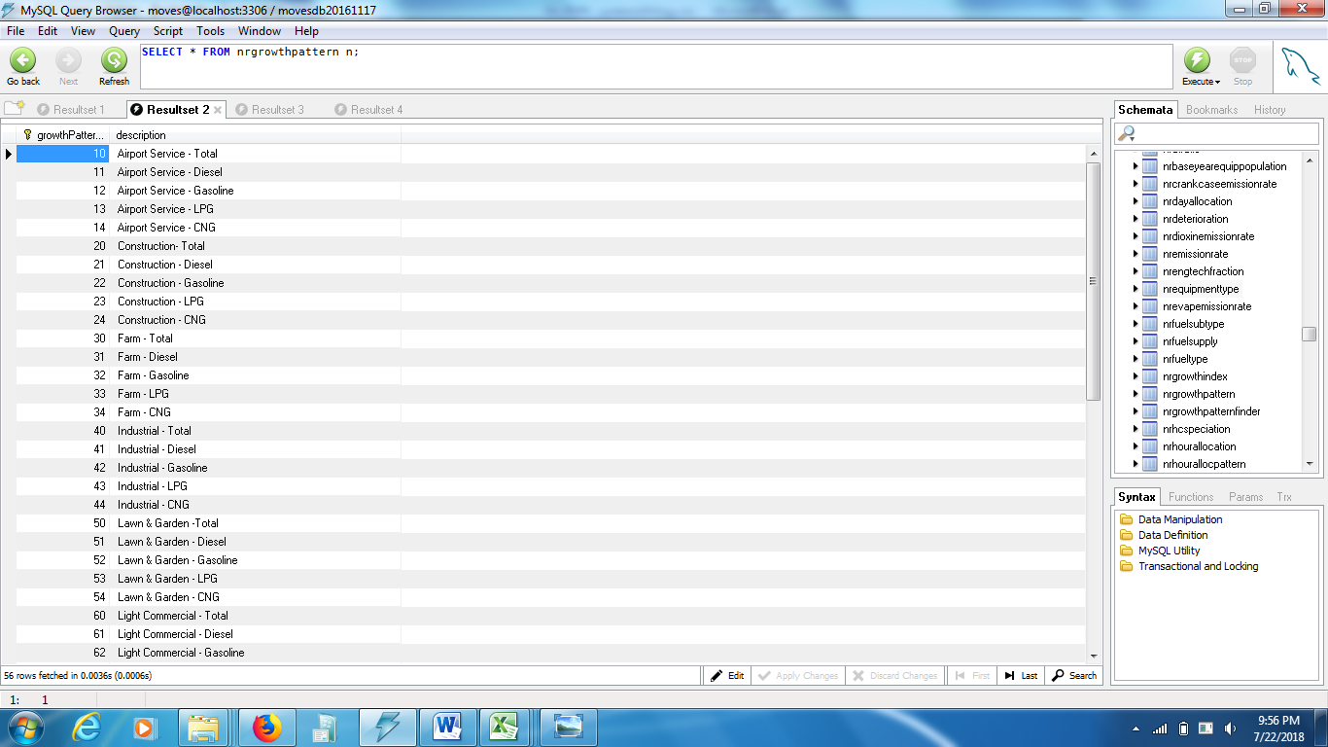
MOVES default database-nrgrowthpattern
12

Slide 13
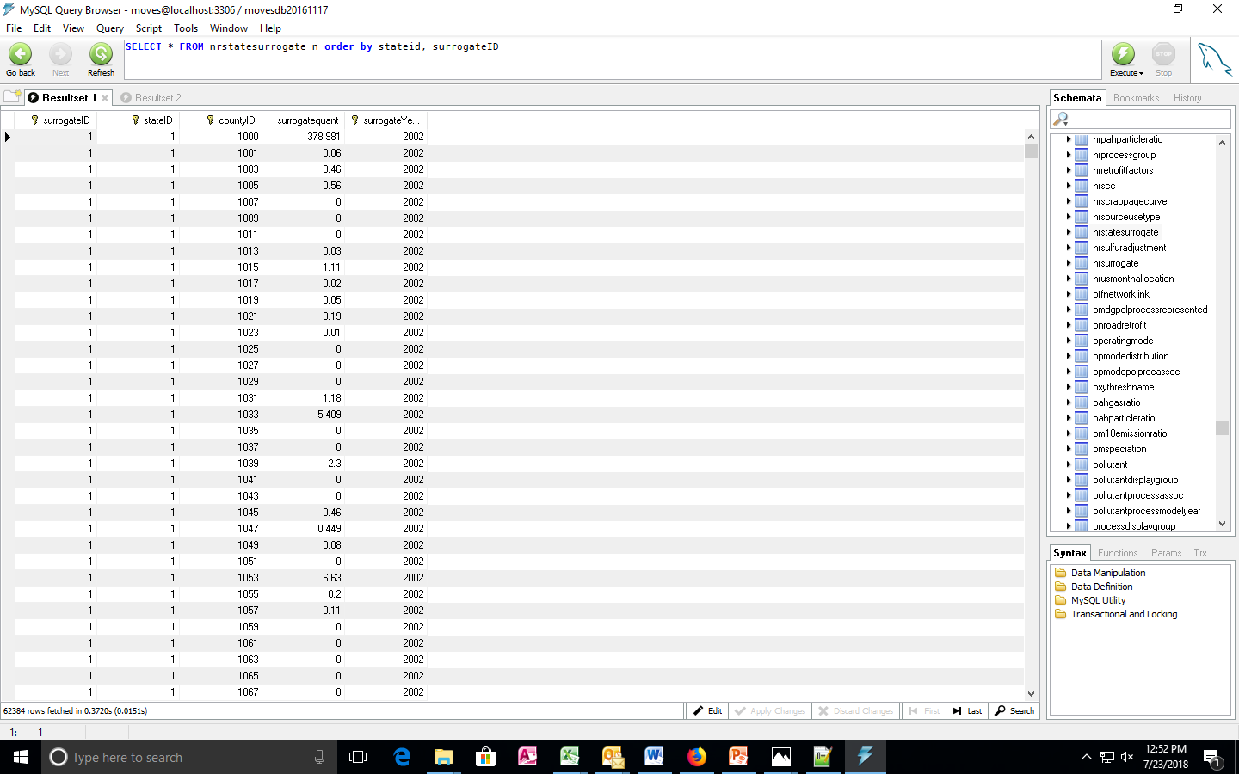
MOVES default database- nrstatesurrogate (final product when we’re done)
13

Slide 14
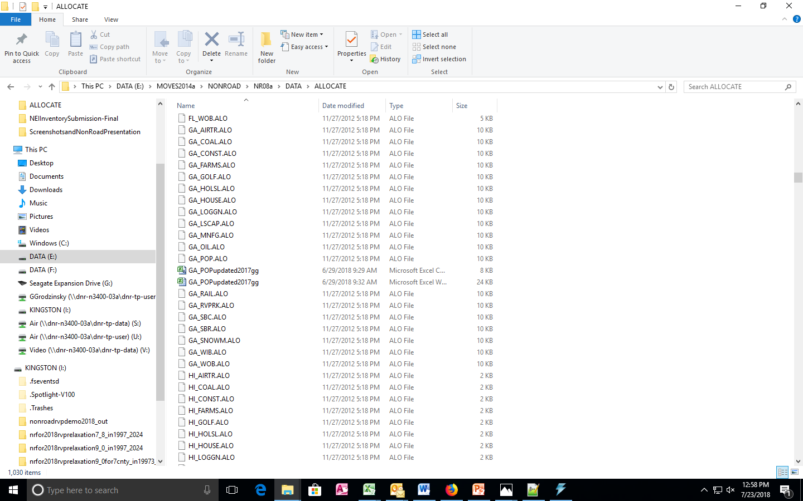
Allocation files included in MOVES installation: …MOVES2014a\NONROAD\NR08a\DATA\ALLOCATE
14

Slide 15
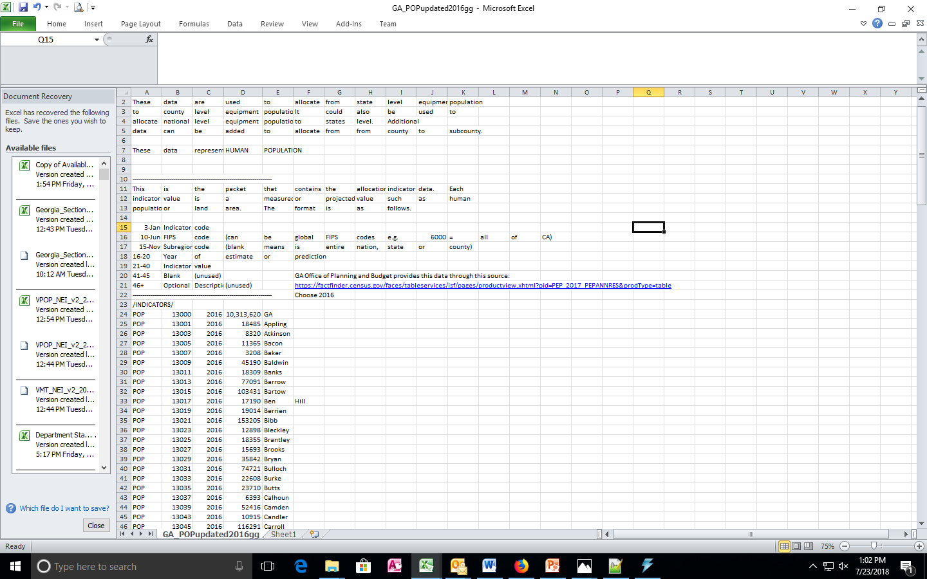
Allocation files included in MOVES installation-UPDATED Population (LIMITED USE)
15

Slide 16
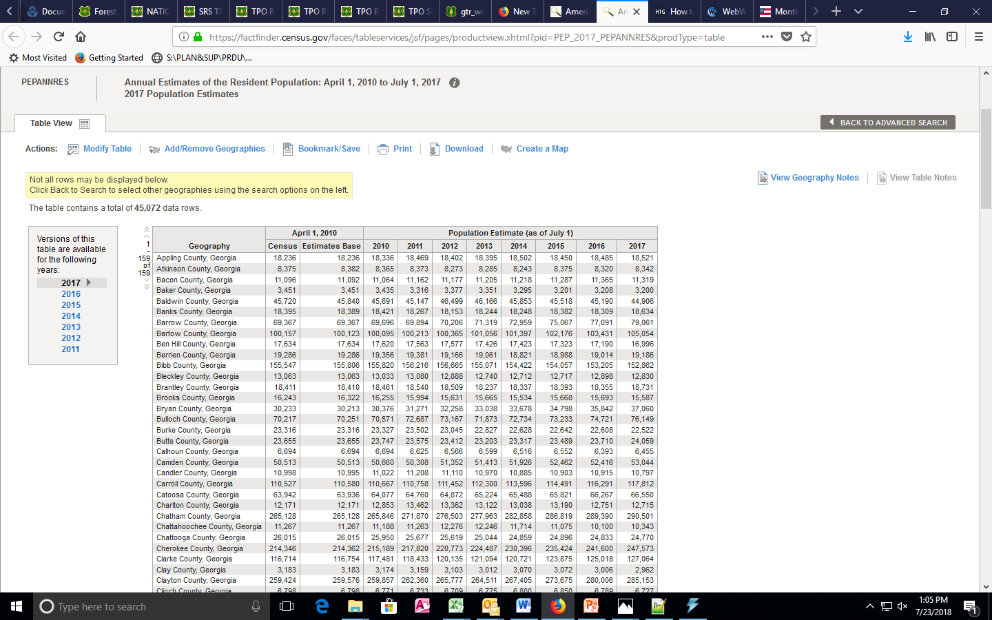
Allocation files included in MOVES installation-UPDATED Population (LIMITED USE)
16

Slide 17
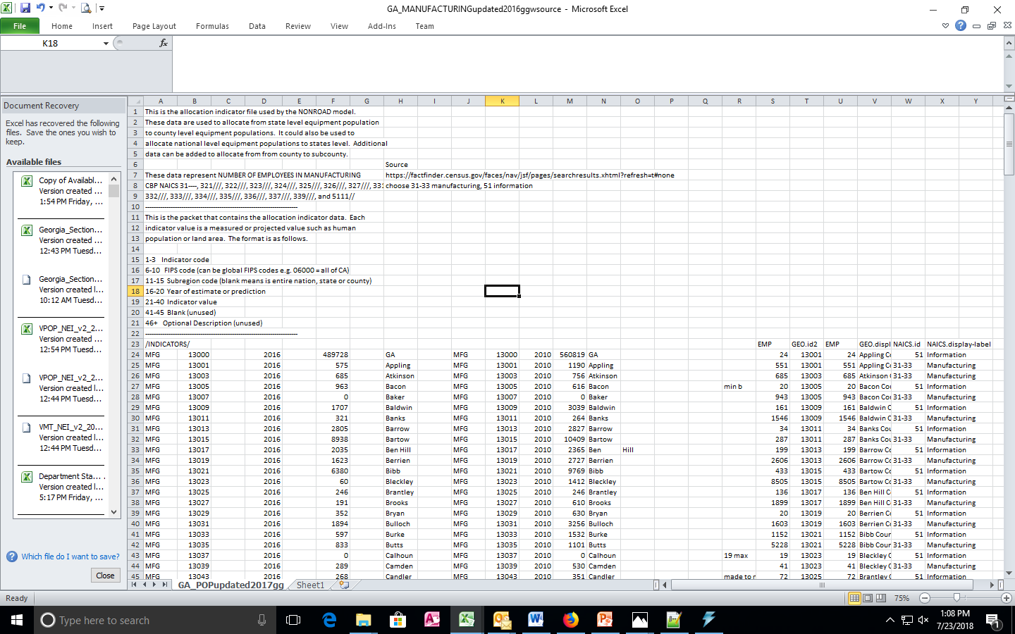
Allocation files included in MOVES installation-UPDATED Manufacturing
17

Slide 18
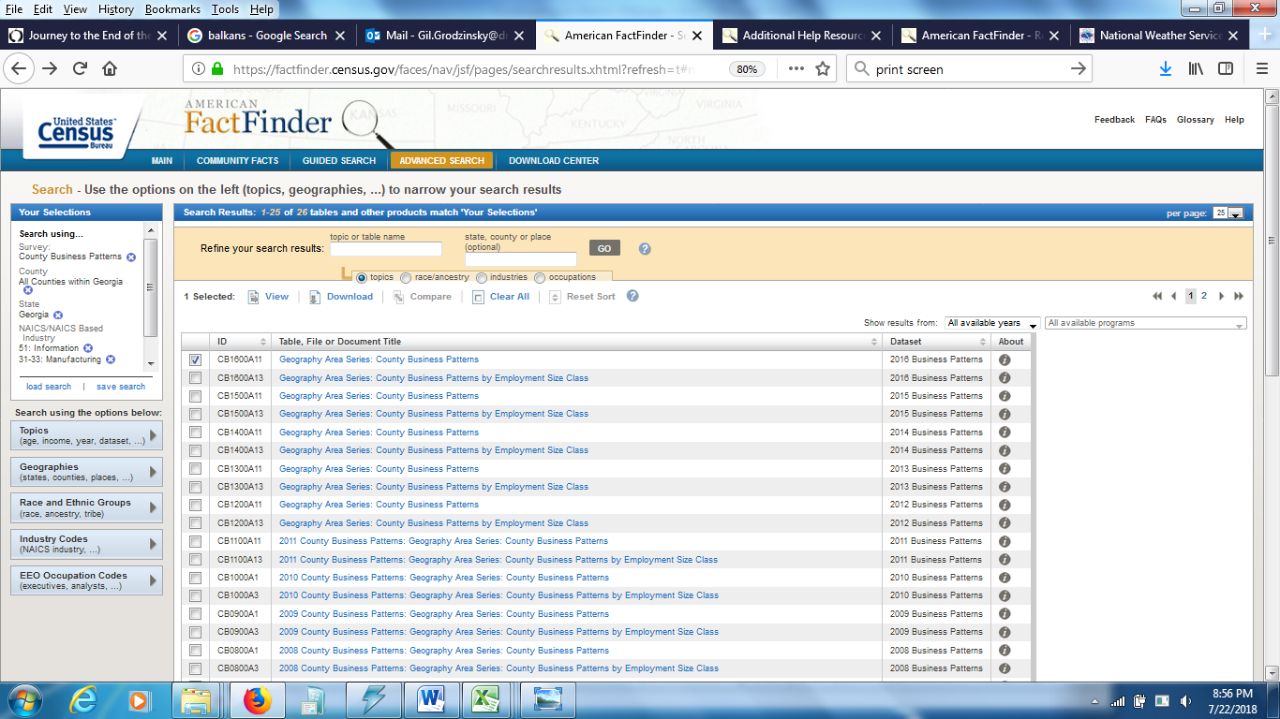
Allocation files included in MOVES installation-UPDATED MANUFACTURING
18

Slide 19
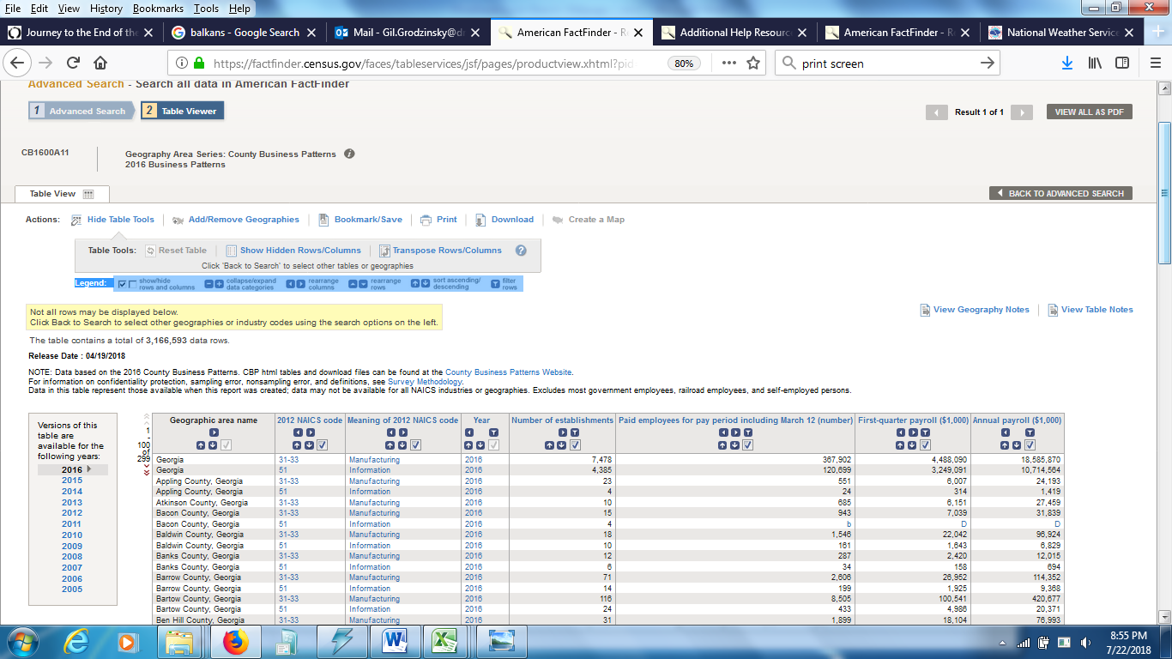
Allocation files included in MOVES installation-UPDATED MANUFACTURING
19

Slide 20
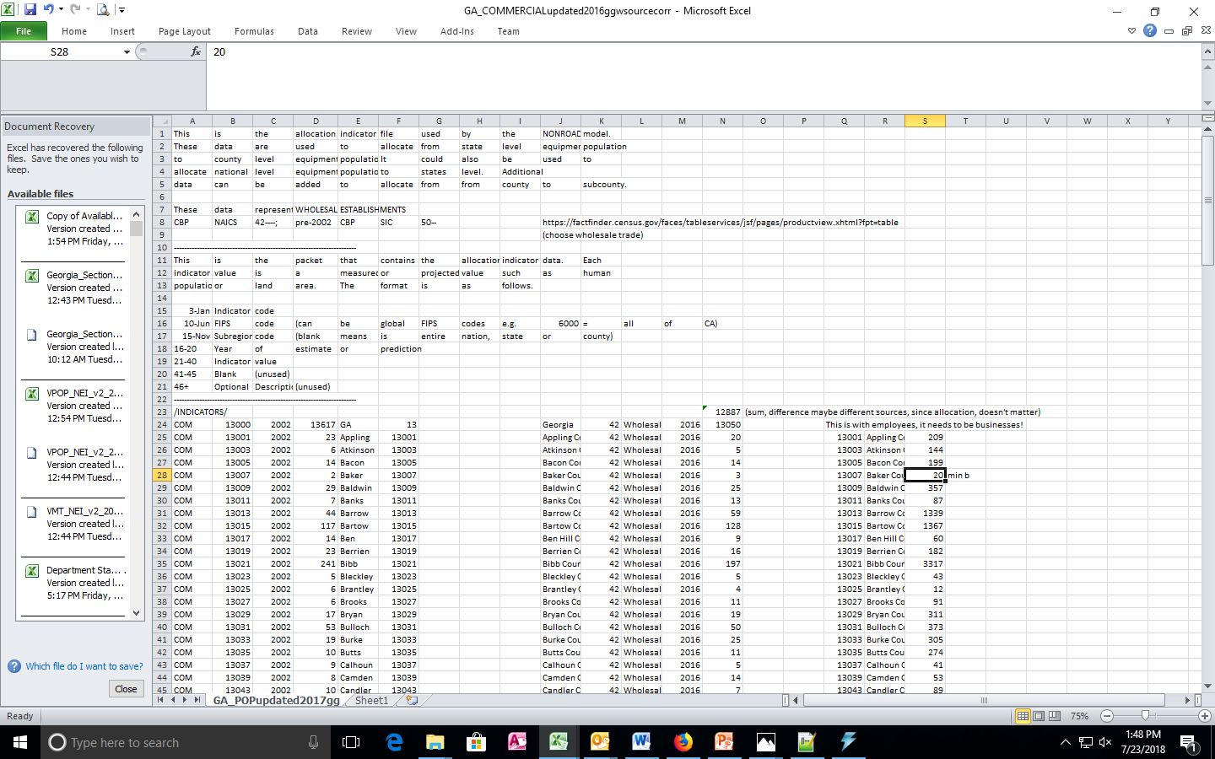
Allocation files included in MOVES installation-UPDATED COMMERCIAL
20

Slide 21
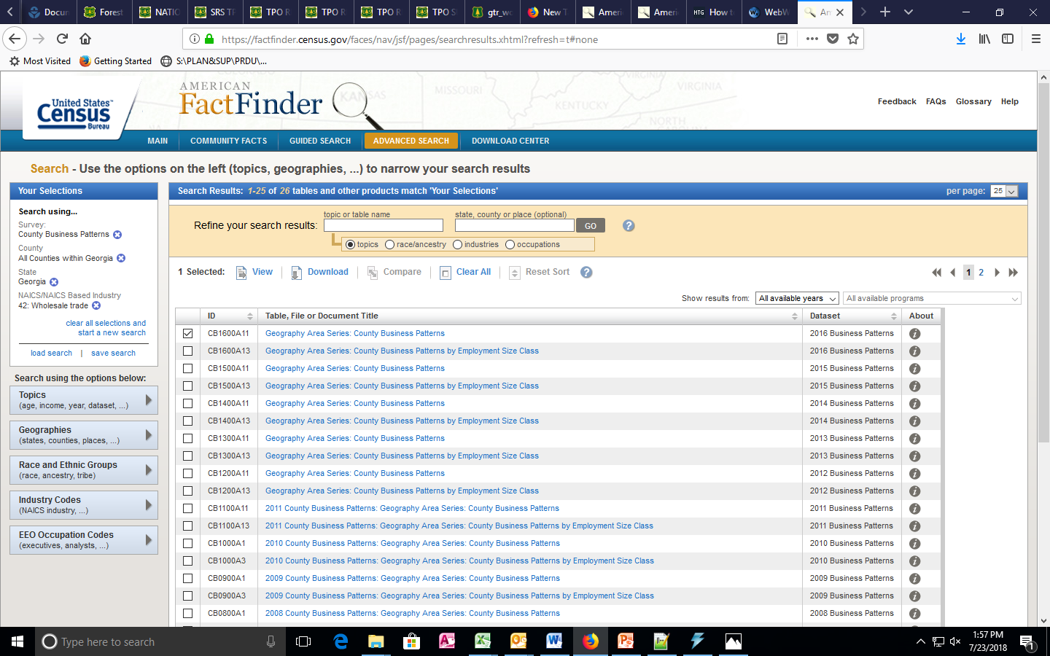
Allocation files included in MOVES installation-UPDATED COMMERCIAL
21

Slide 22
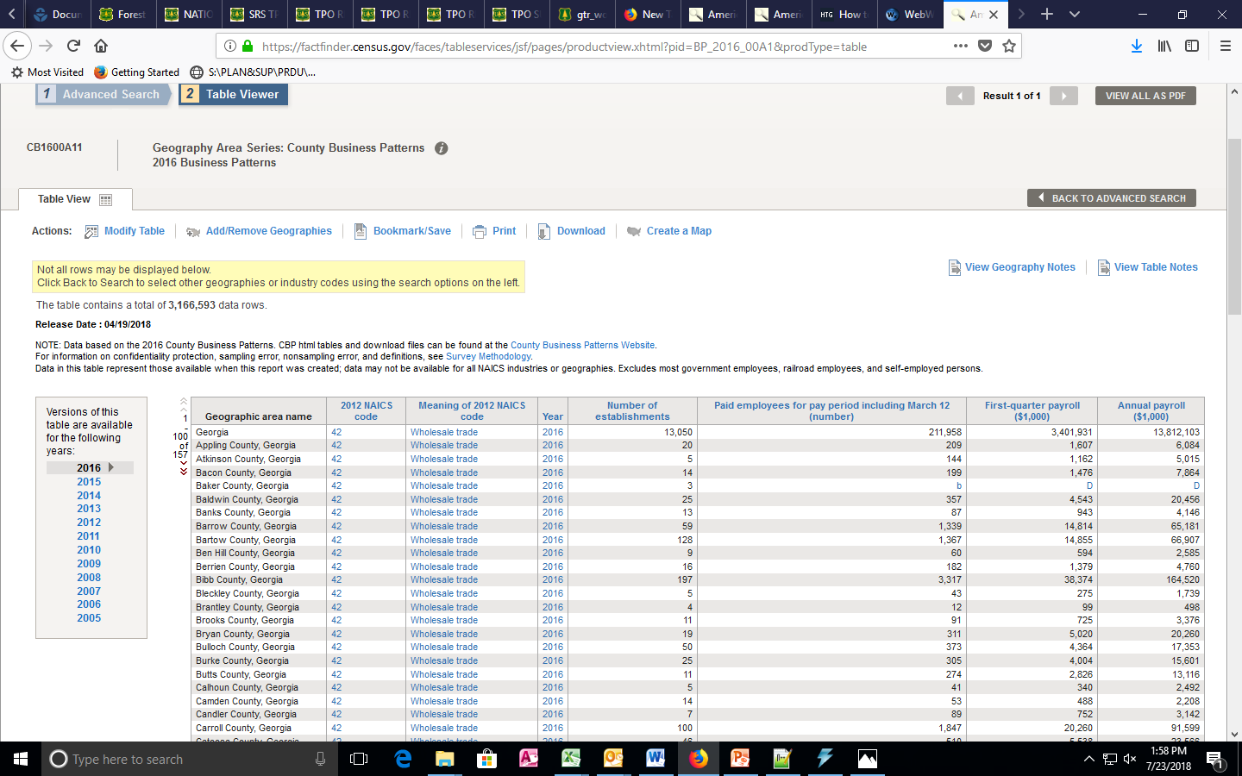
Allocation files included in MOVES installation-UPDATED COMMERCIAL
22

Slide 23
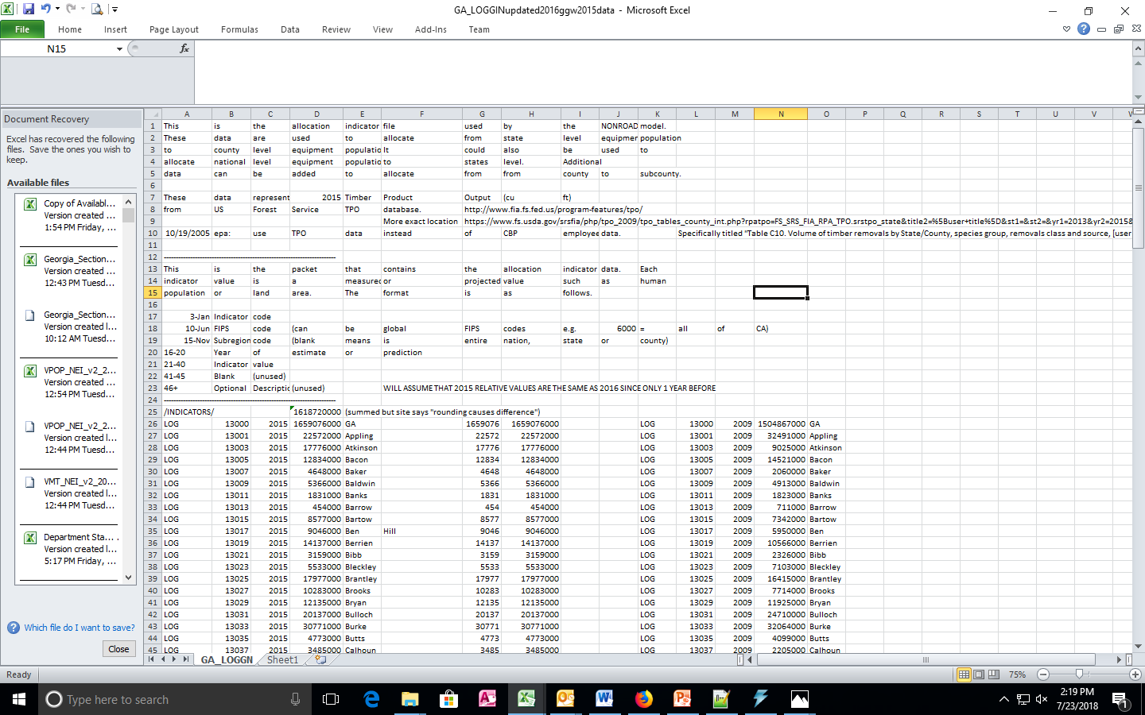
Allocation files included in MOVES installation-UPDATED Logging
23

Slide 24
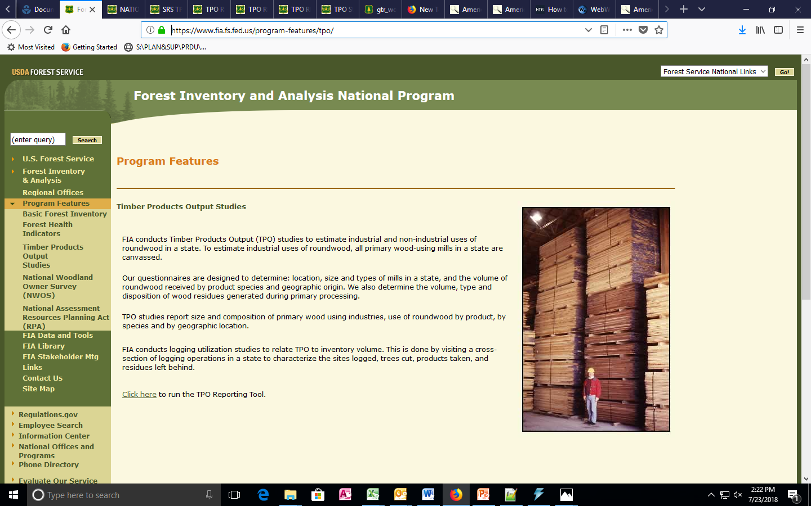
Allocation files included in MOVES installation-UPDATED LOGGING
24

Slide 25
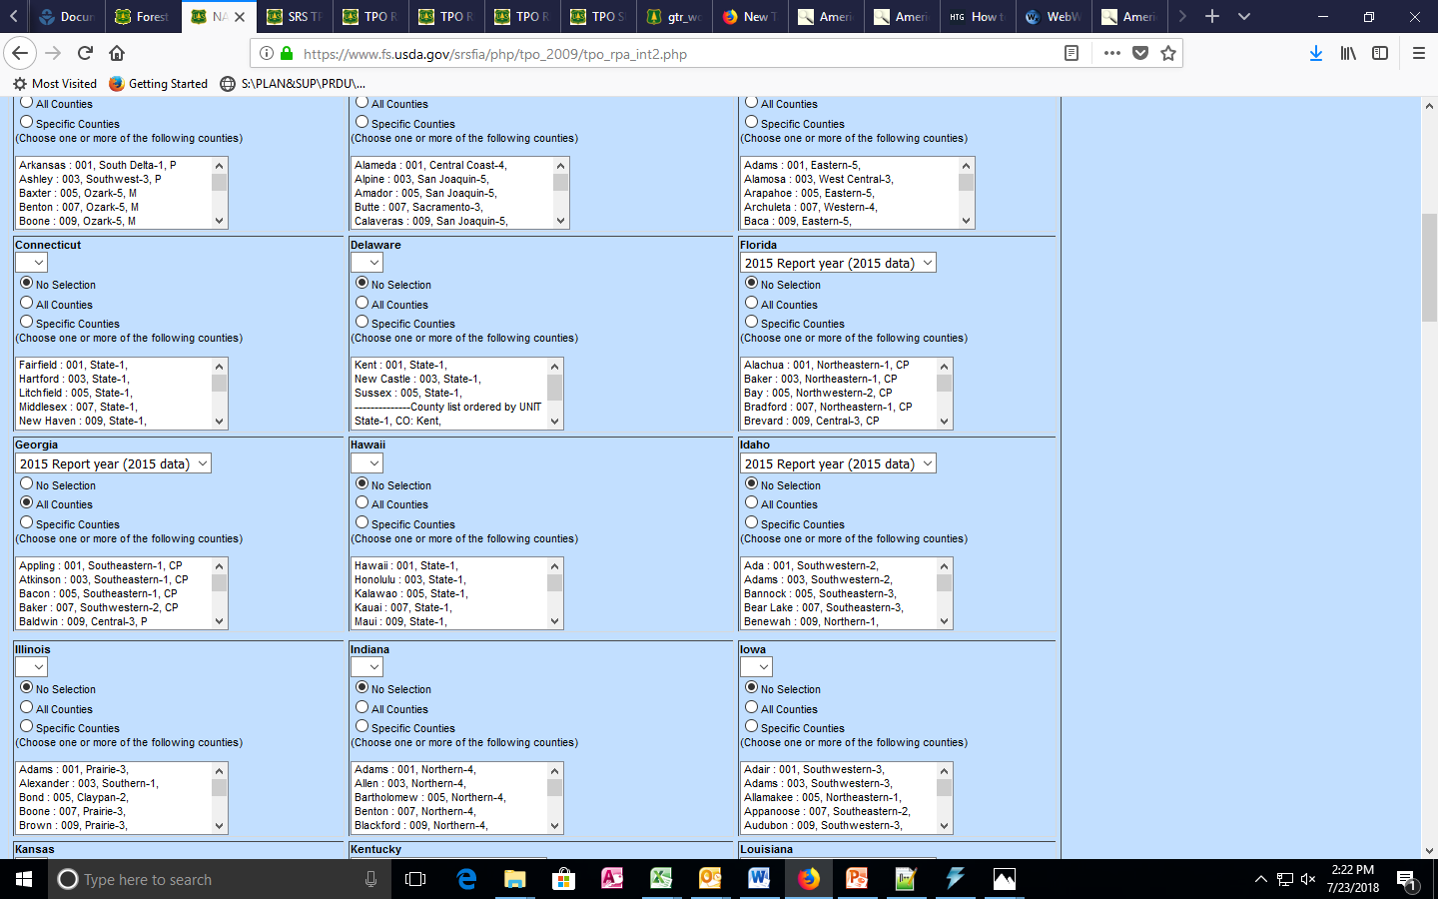
Allocation files included in MOVES installation-UPDATED LOGGING
25

Slide 26
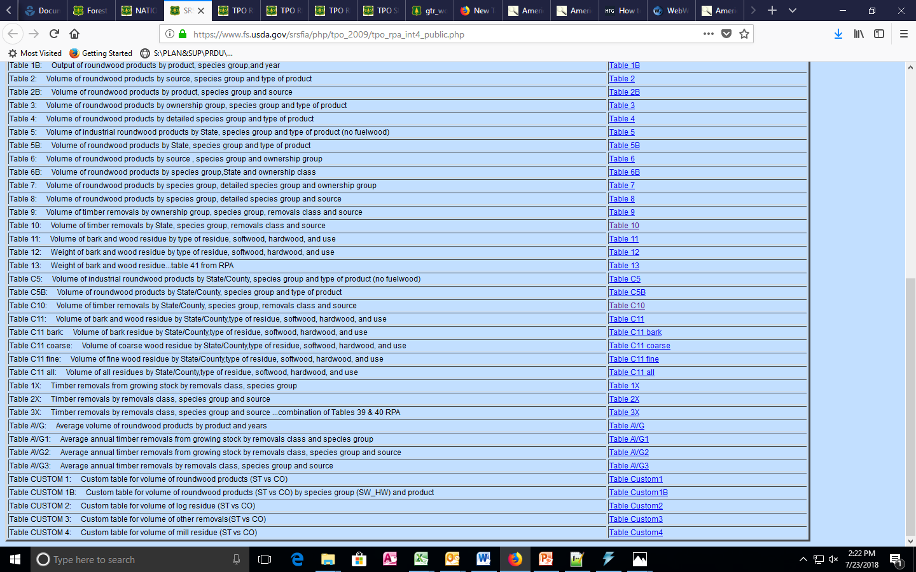
Allocation files included in MOVES installation-UPDATED LOGGING
26

Slide 27
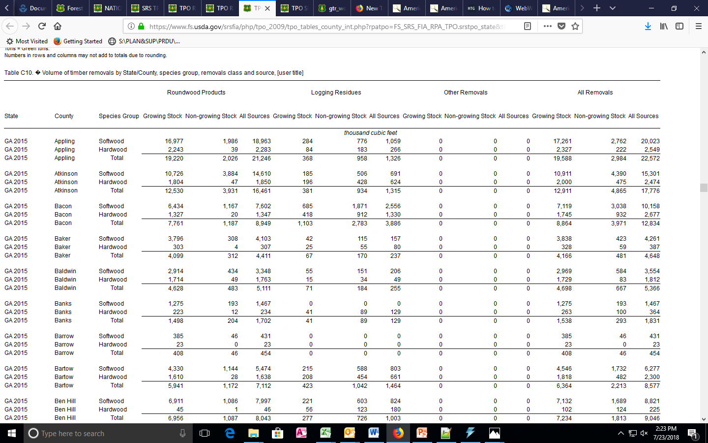
Allocation files included in MOVES installation-UPDATED LOGGING
27

Slide 28
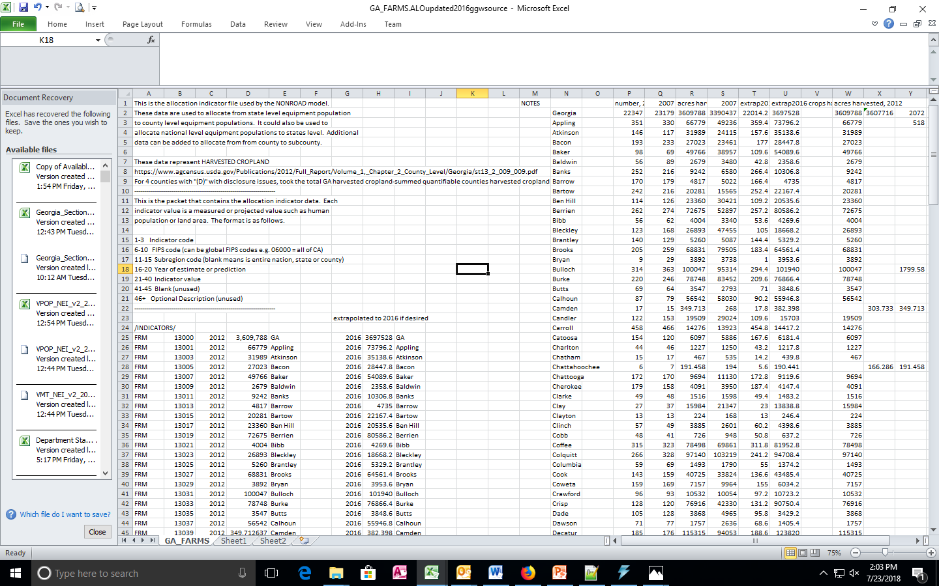
Allocation files included in MOVES installation-UPDATED AGRICULTURE
28

Slide 29
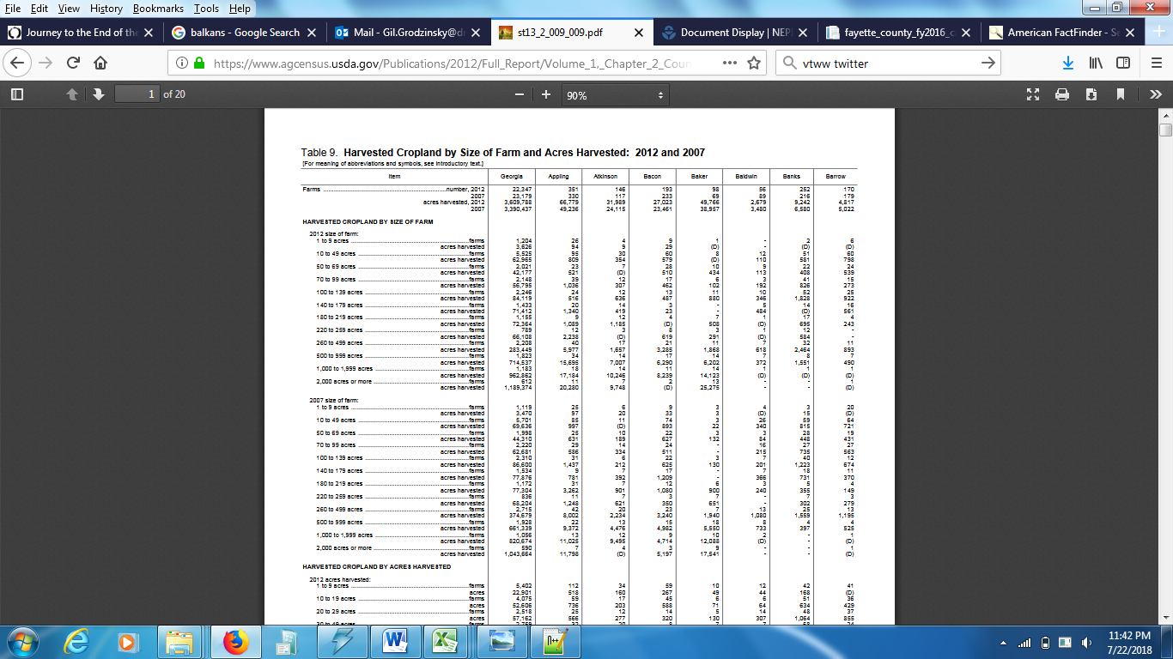
Allocation files included in MOVES installation-UPDATED AGRICULTURE
29

Slide 30
Allocation files included in MOVES installation-UPDATED AGRICULTURE
      Agriculture data only 2007 and 2012
      Extrapolated to 2016
      Four counties lacking data took 2007 cropland values and grew it based on number of farms in 2012 versus 2007 local
      Summed the total between the 4 counties and then compared with difference between GA total cropland and sum of individual counties (155 counties that did have county level data)
      Adjusted 4 county values so they would sum to difference
30

Slide 31
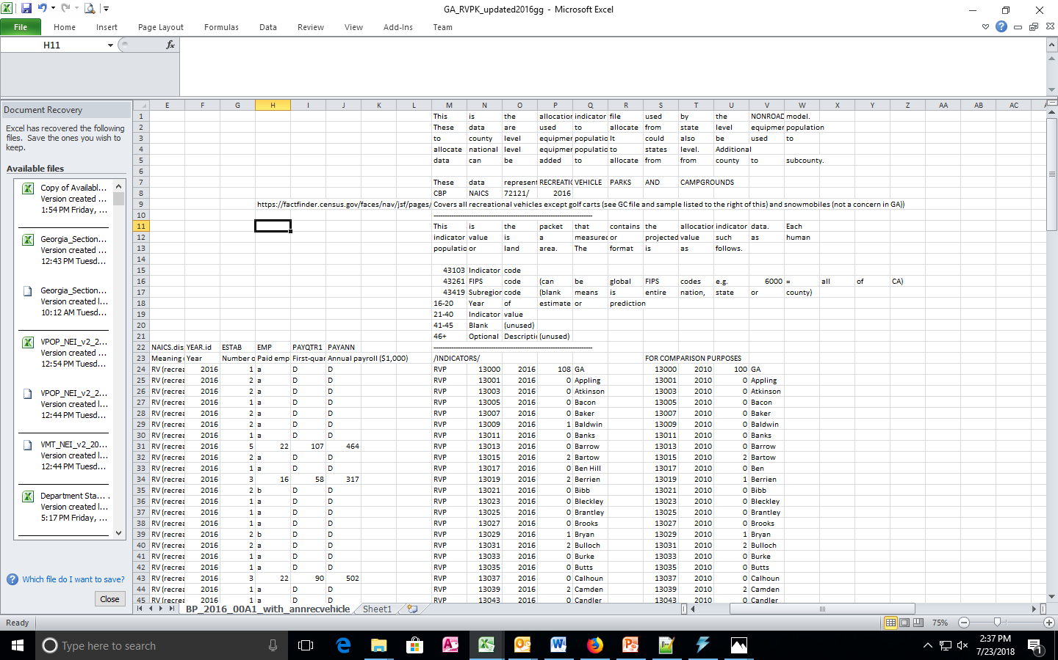
Allocation files included in MOVES installation-UPDATED RECreationaL VEHICLES (no GOLF CARTS-SNOWMOBILES)
31

Slide 32
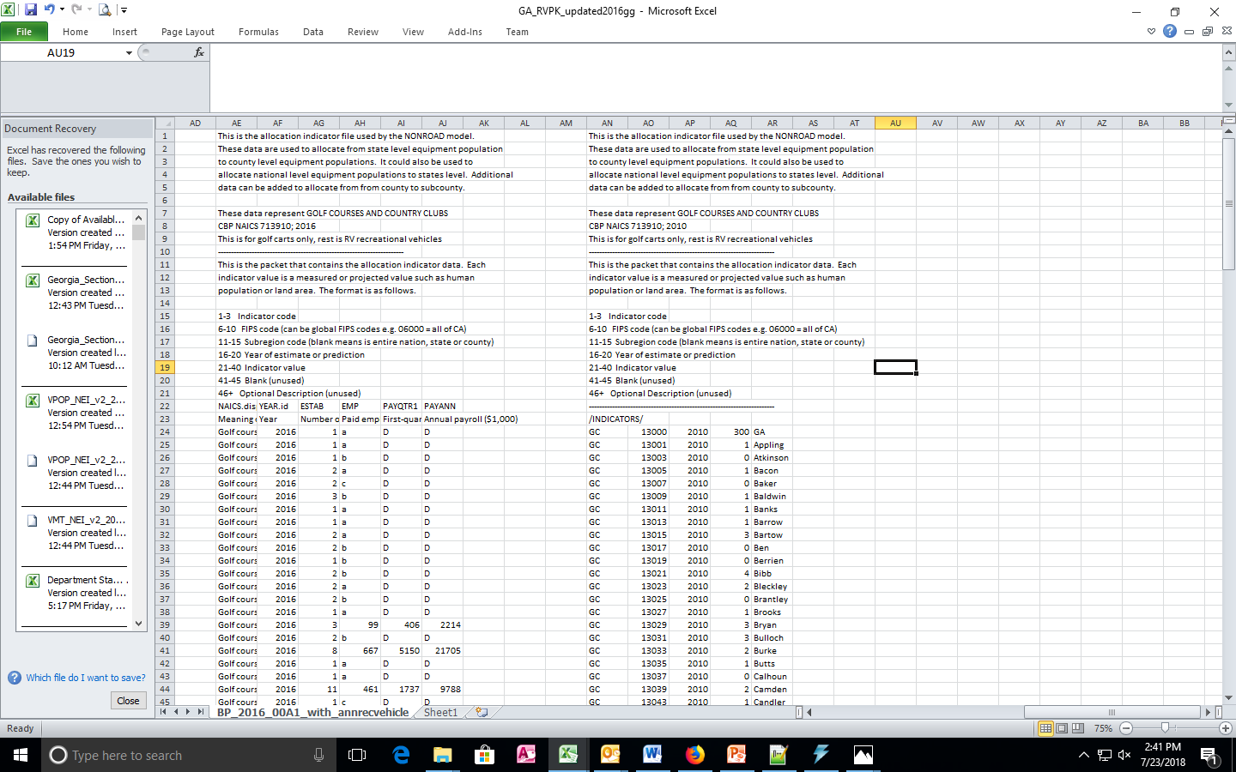
Allocation files included in MOVES installation-UPDATED RECREATIONAL VEHICLES GOLF CARTS ONLY
32

Slide 33
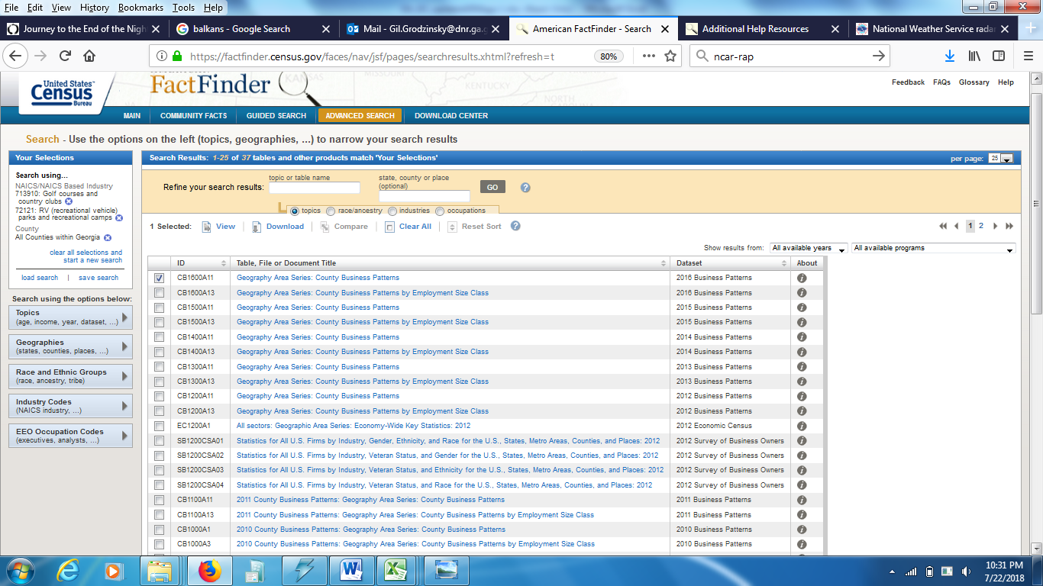
Allocation files included in MOVES installation-UPDATED RECREATIONAL VEHICLES
33

Slide 34
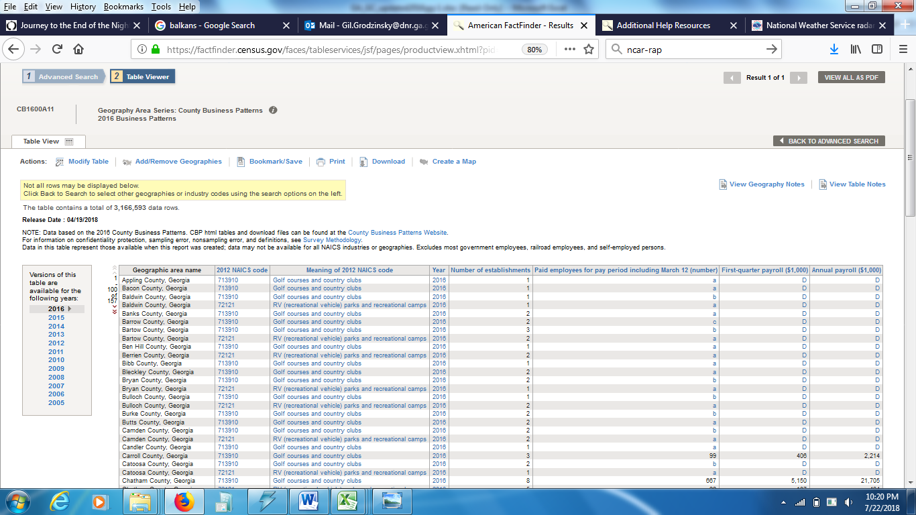
Allocation files included in MOVES installation-UPDATED RECREATIONAL VEHICLES
34

Slide 35
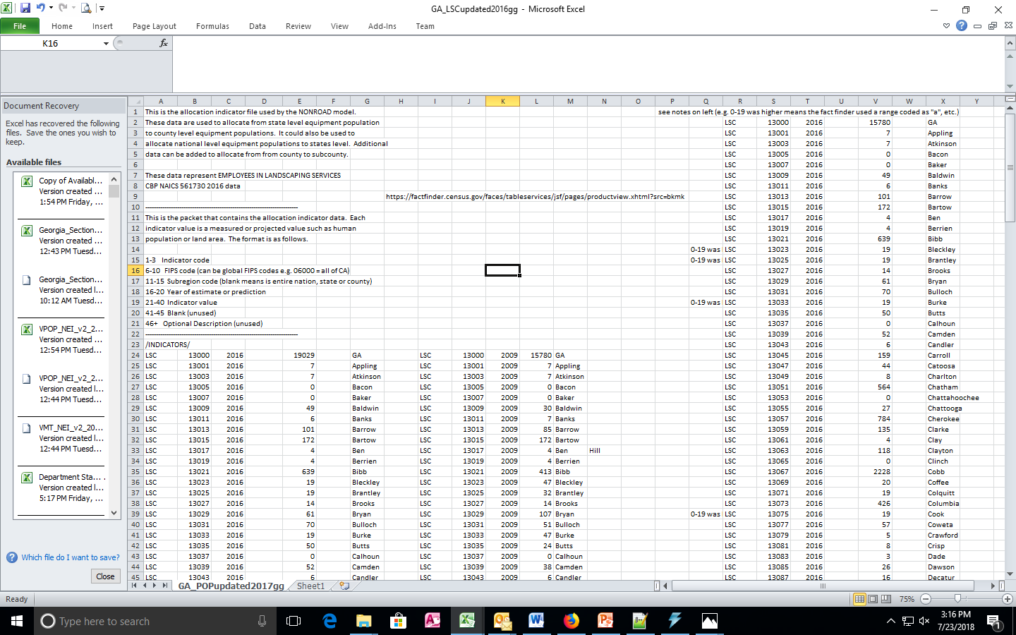
Allocation files included in MOVES installation-UPDATED LAWn/Garden VEHICLES (COMMERCIAL ONLY)
35

Slide 36
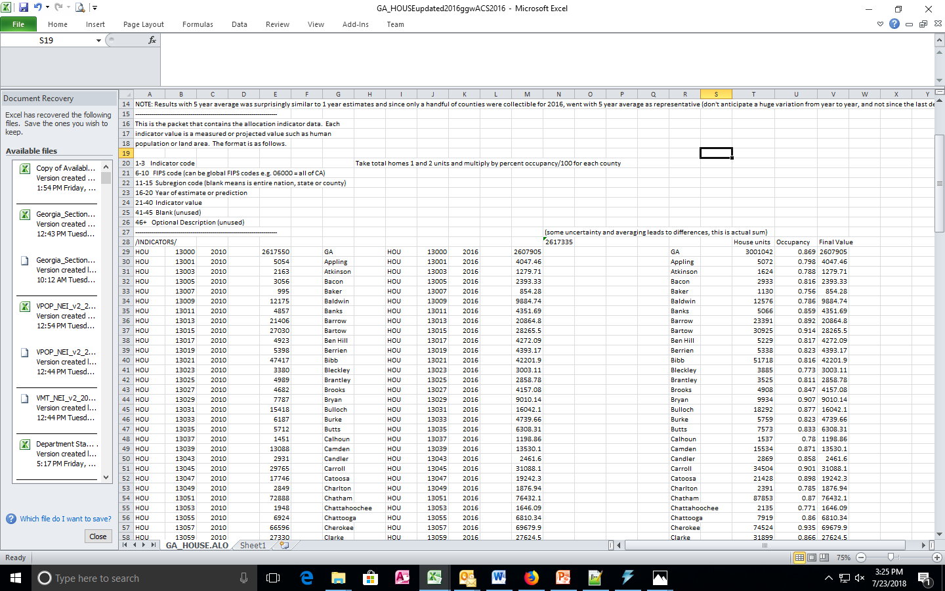
Allocation files included in MOVES installation-UPDATED LAWN/GARDEN VEHICLES (RESIDENTIAL ONLY)-HOUSING UNITS
36

Slide 37
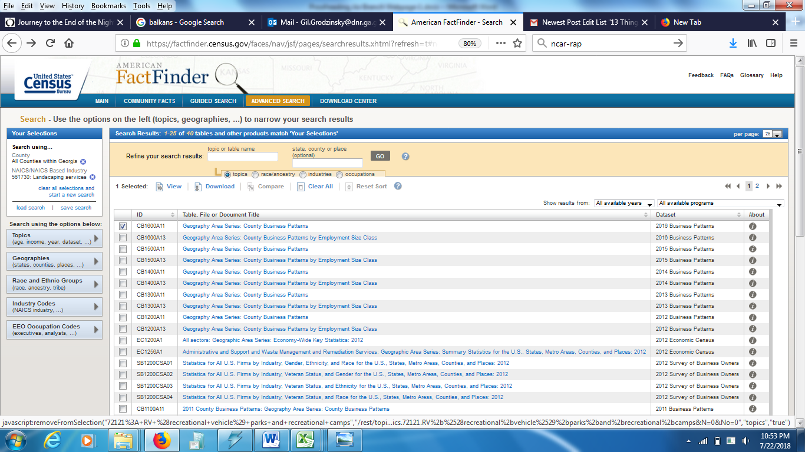
Allocation files included in MOVES installation-UPDATED LAWN/GARDEN VEHICLES (COMMERCIAL ONLY)
37

Slide 38
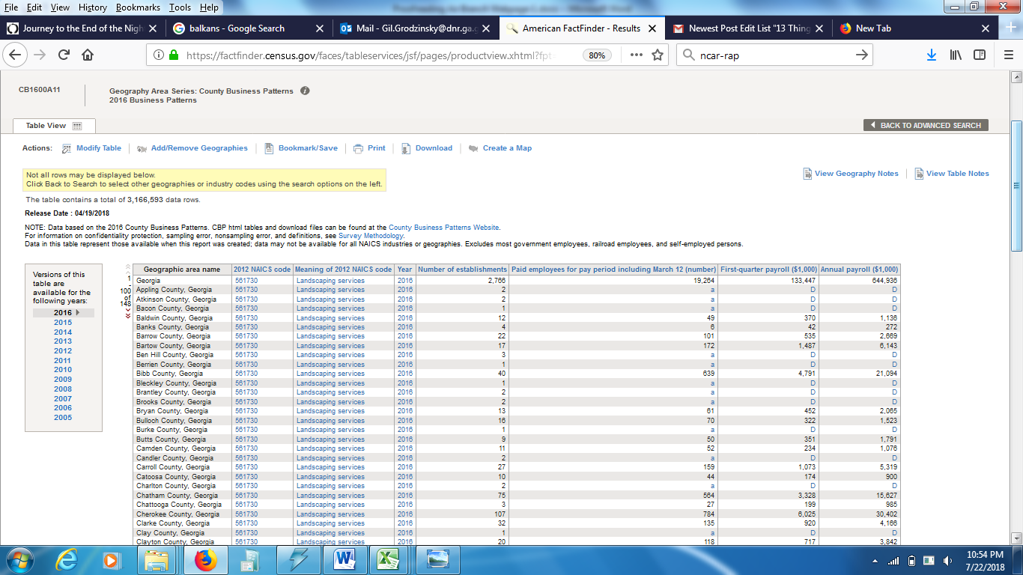
Allocation files included in MOVES installation-UPDATED LAWN/GARDEN VEHICLES (COMMERCIAL ONLY)
38

Slide 39
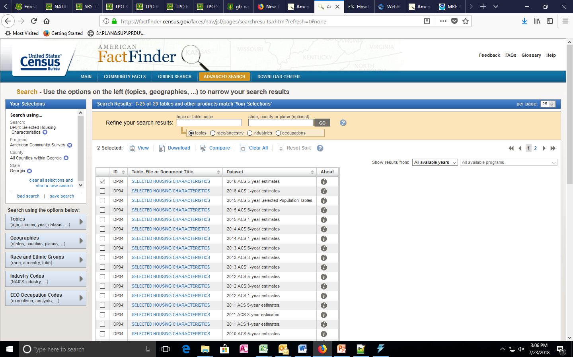
Allocation files included in MOVES installation-UPDATED LAWN/GARDEN VEHICLES (RESIDENTIAL ONLY)-HOUSING UNITS
39

Slide 40
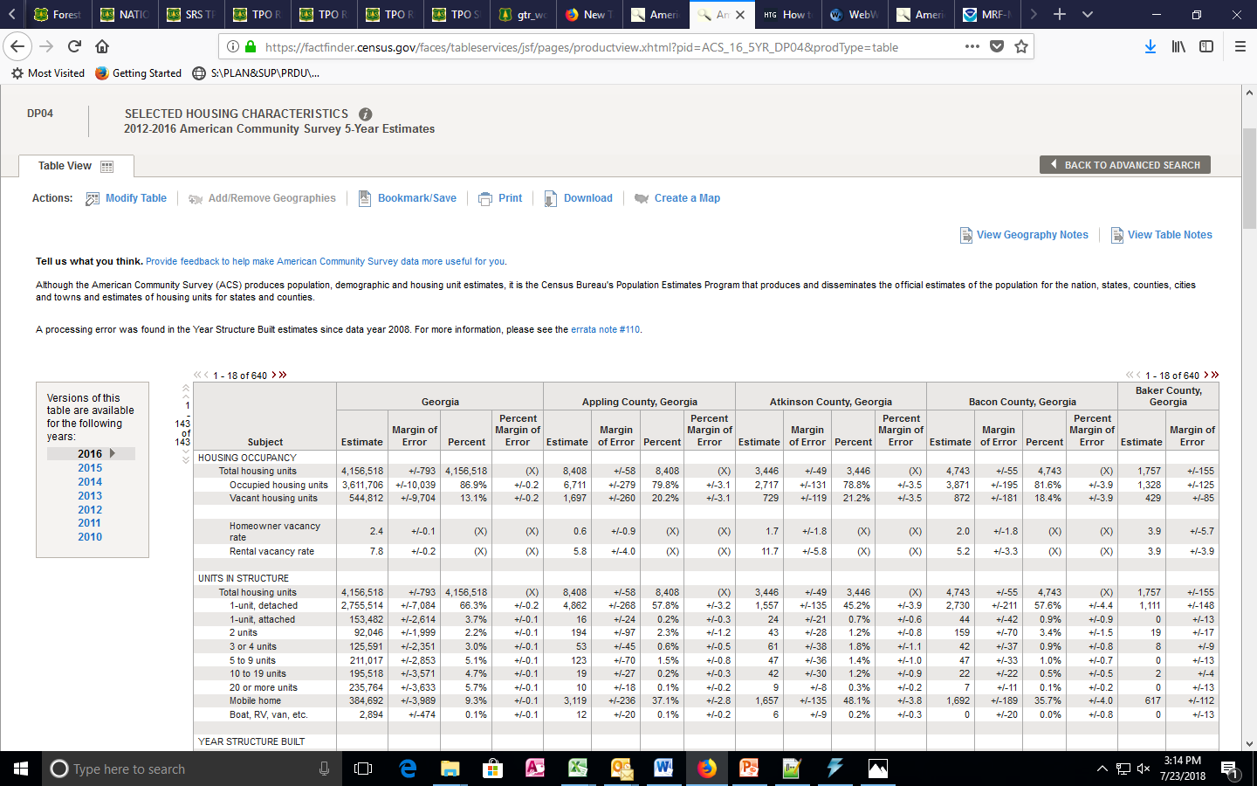
Allocation files included in MOVES installation-UPDATED LAWN/GARDEN VEHICLES (RESIDENTIAL ONLY)-HOUSING UNITS
40

Slide 41
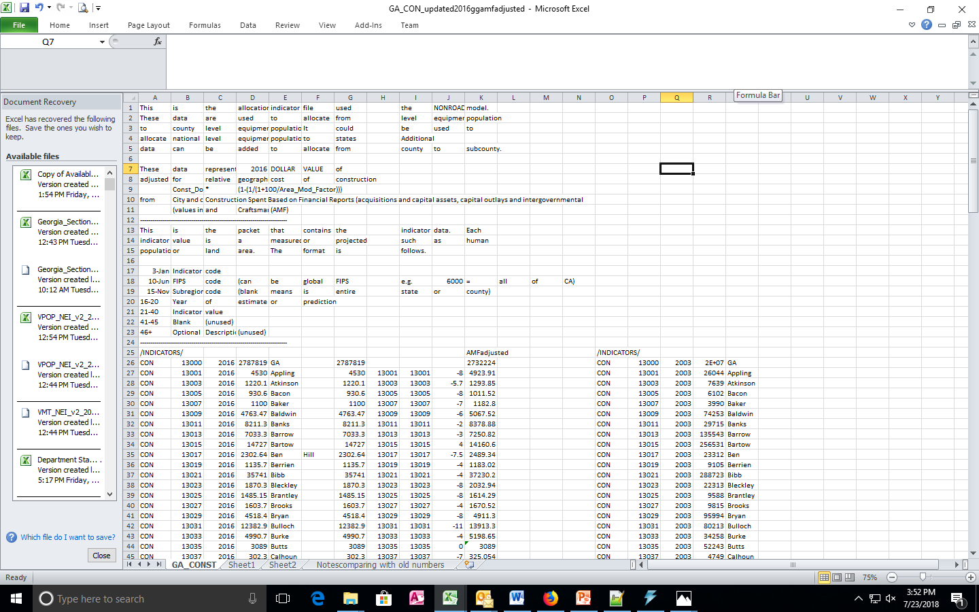
Allocation files included in MOVES installation-UPDATED CONSTRUCTION VEHICLES
41

Slide 42
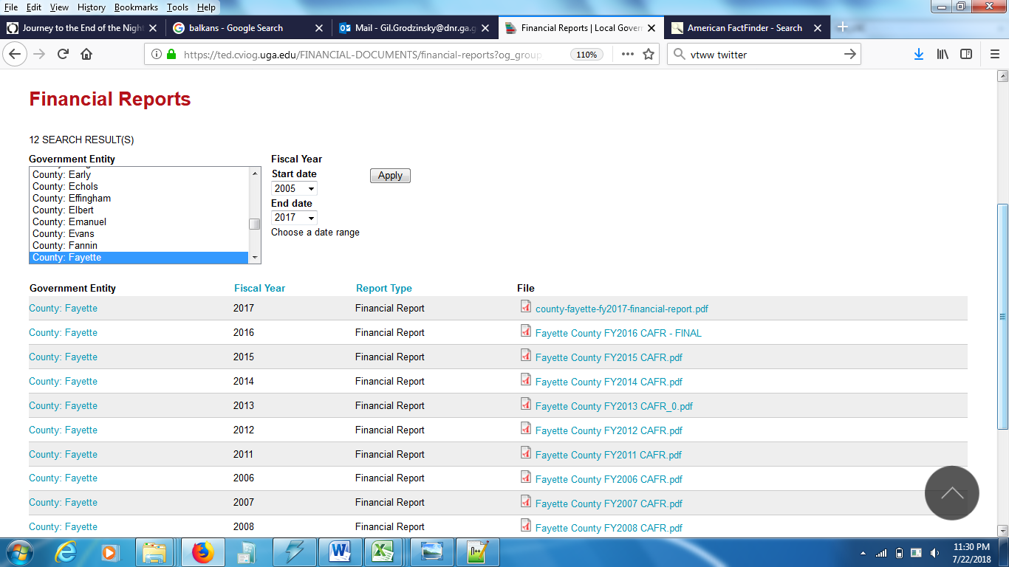
Allocation files included in MOVES installation-UPDATED CONSTRUCTION VEHICLES
42

Slide 43
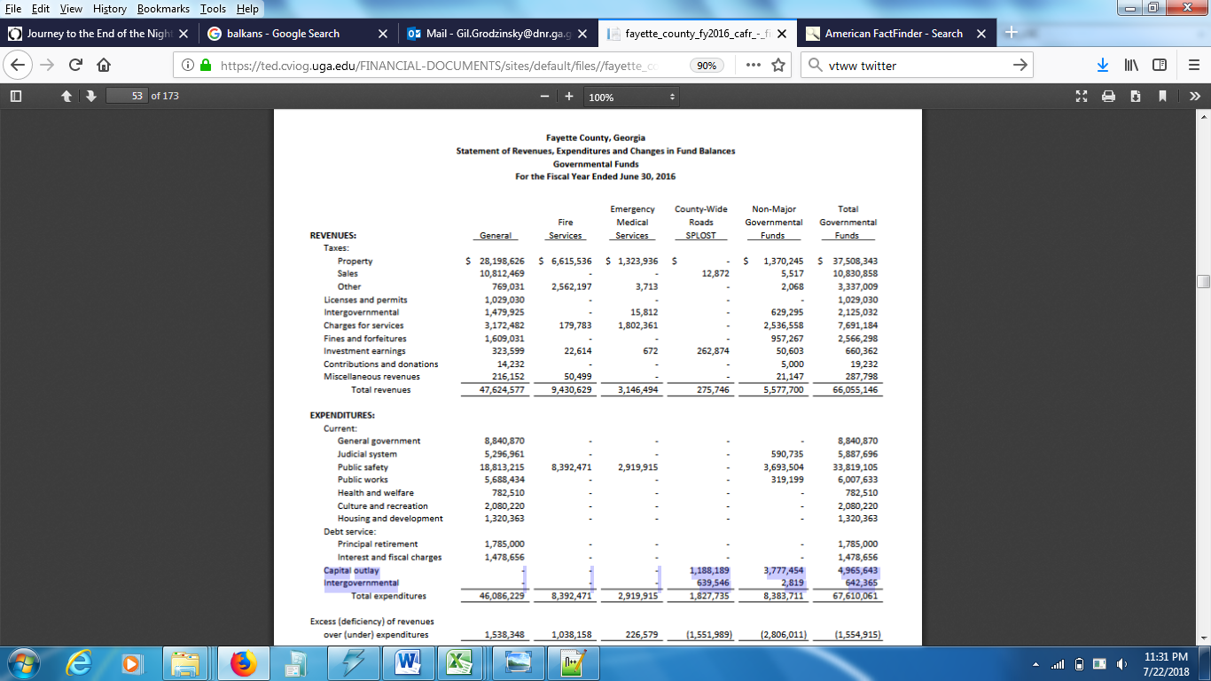
Allocation files included in MOVES installation-UPDATED CONSTRUCTION VEHICLES
43

Slide 44
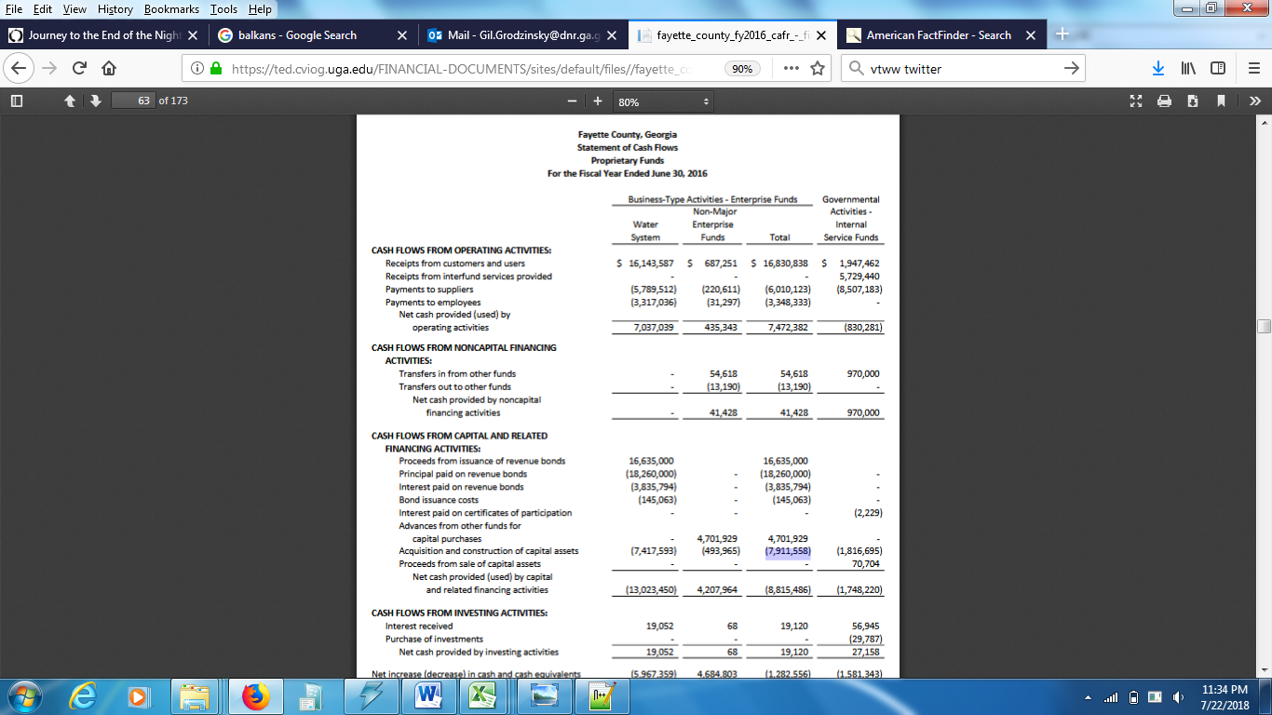
Allocation files included in MOVES installation-UPDATED CONSTRUCTION VEHICLES
44

Slide 45
Alternative DATA SOURCES IF ABOVE SOURCE IS INADEQUATE/UNAVAILABLE-UPDATED CONSTRUCTION
      Use financial report and locate SPLOST money for Roads & Bridges (only road construction, but considered by far largest portion of work)
      School budget assessment/financial report (roads and buildings, only one case this was done when no data available and schools make up nearly all public outlays and works there)
      State Transportation Improvement Plan (STIP) (have to often estimate how funds are split if over several counties, includes roads, bridges, and buildings which impact roads (which is most cases)
      Use financial report estimate of money allayed to public works (only 1 case used, often this money is not all spent)
45

Slide 46
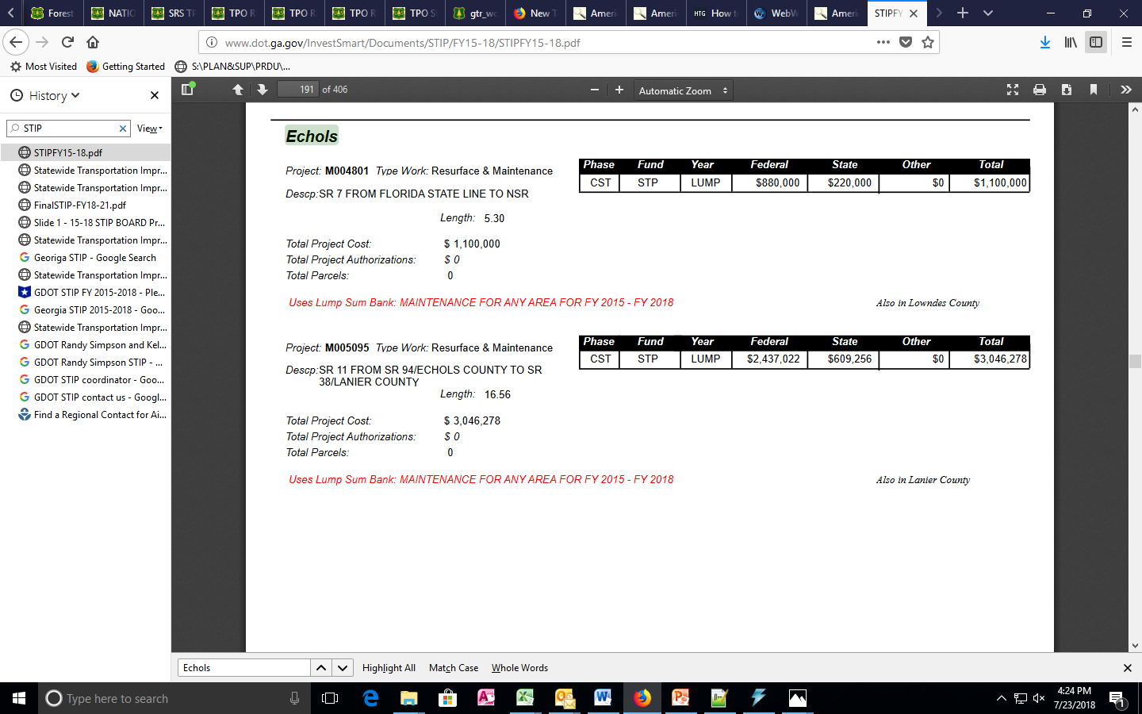
Alternative DATA SOURCES IF ABOVE SOURCE IS INADEQUATE/UNAVAILABLE-UPDATED CONSTRUCTION: STIP
46

Slide 47
Important to Note WITH CONSTRUCTION
      Need to adjust for local value of dollar, this is provided by Craftsman Book Company-called AMF (Area Modification Factor)
      Incorporated cities in higher populated counties need to be especially looked at separately from county financial reports (with exception of Atlanta, only looked at the Proprietary Report with Cash Flow, double check to see if there are city level funding independent of county like SPLOST, but rare)
      Not incorporated cities assume part of county
      For small counties (lower population), other than if numbers at county level look unrealistically small, cities are small and likely don’t add anything (but if want can check Proprietary funds-Cash Flow-acquisitions and construction of capital assets, go ahead and if number is larger than county value, then use it)
47

Slide 48
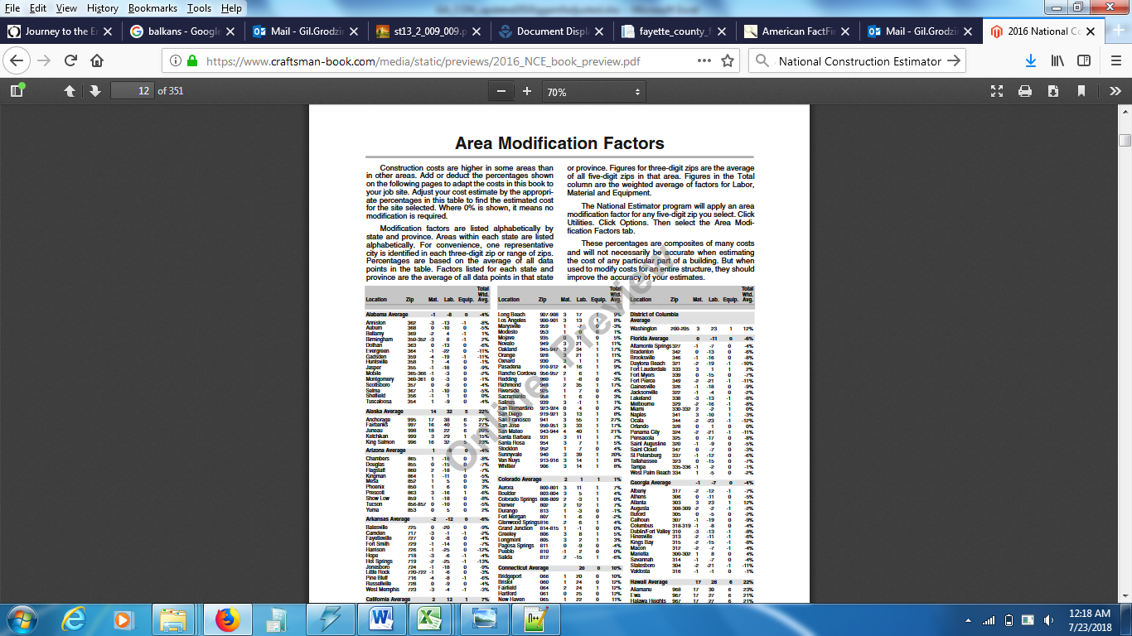
Important to Note WITH CONSTRUCTION: APPLY AMF
48

Slide 49
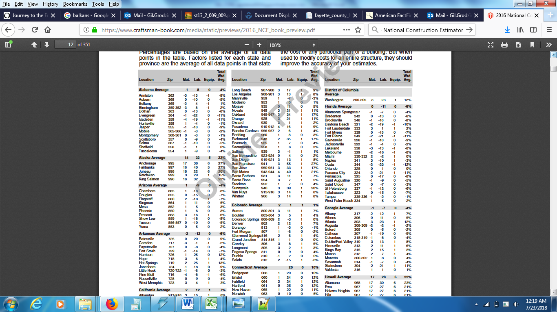
Important to Note WITH CONSTRUCTION: APPLY AMF
49

Slide 50
IMPACT OF NEW ALLOCATIONS ON EMISSIONS
      Tested new numbers by replacing old allocations with new allocations in the nrstatesurrogates input table in MOVES default table for Georgia counties (created a second MOVES default database with name indicated this)
      Ran MOVES before and after change (with proposed and current MOVES default database)
      Compared numbers for 13 county Atlanta area (other inputs based on 110(l) demonstration we are currently conducting, newest assumptions we have)
      8% increase in emissions NOx, 12% decrease in emissions VOC
      NOx dependent on construction, VOC on landscaping the most
50

Slide 51
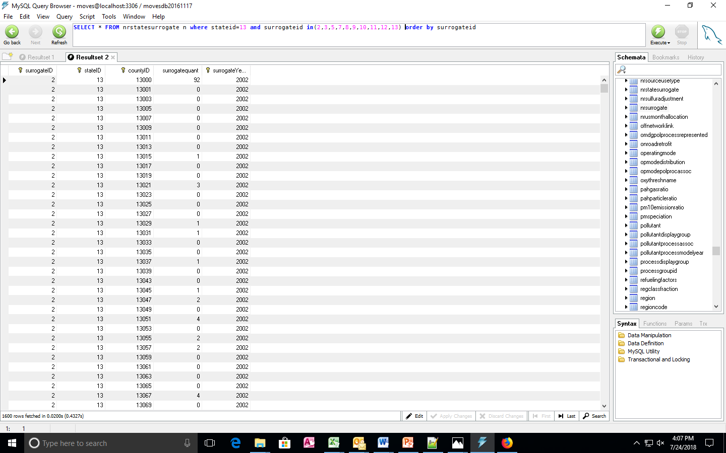
MOVES default database- nrstatesurrogate currently for recreational vehicles
51

Slide 52
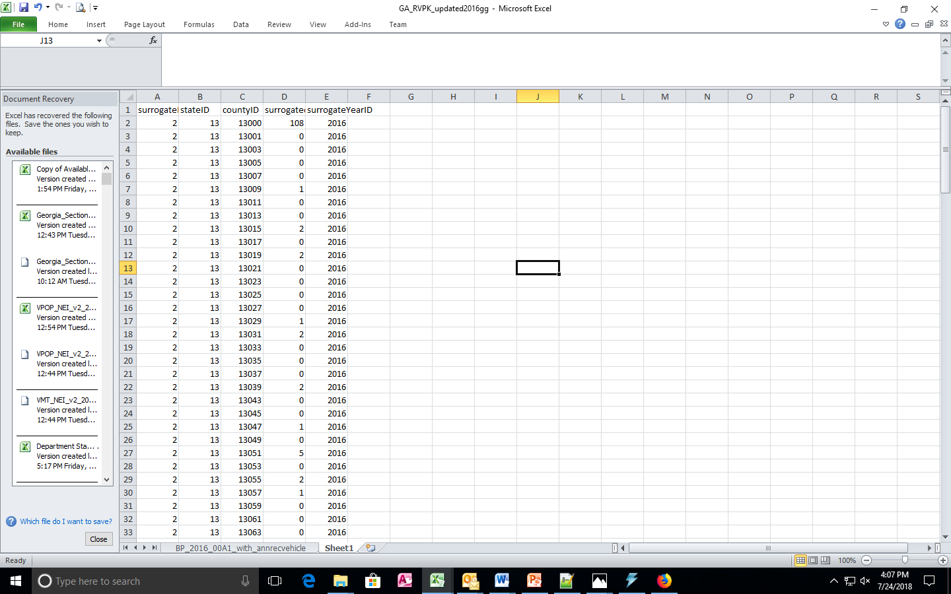
MOVES default database- nrstatesurrogate replacement (recreational vehicles)
52

Slide 53
Contact Information
Gil Grodzinsky, Ph.D.
Georgia Dept. of Natural Resources
4244 International Parkway, Suite 120
Atlanta, GA 30354
Gil.Grodzinsky@dnr.ga.gov
404-363-7123
Notes:
No major changes to VOC or NOX emissions between 2009 OTW BaseD and 2009 OTW BaseG4 (used in SIPs) inventories.

